Slide 1
INTRODUCTION TO MEDICAL SURGICAL NURSING

Slide 2
MAIN OBJECTIVE:
To acquire knowledge on medical-surgical nursing and develop skills and attitudes in the management of patients with medical and surgical conditions.
SUB-OBJECTIVES
The student will be able to:
Discuss historical development of Medicine and Surgery.
Classify the disease/condition according to their etiology.
Describe the disease process (Pathophysiology)
Describe common medical-surgical conditions

Slide 3
Assignment
1. Write notes on historical development of Medicine and Surgery

Slide 4
Background
Medical /surgical nursing- broad nursing specialty that provide care for adult patients with either /both acute and chronic conditions.
This requires broad knowledge on body system, surgical and medical pathologies, clinical skills, clinical decision making as well as collaborative skills.
According to Florence Nightingale, the goal of nursing was to put the patient in the best condition for nature to act upon him.
.

Slide 5
Cont’----
Roles of the Nurse in medical surgical nursing
Nurse practitioner- makes interventions, teaches patient,families and communities and also collaborates care
Leadership role- this role demands ,decision making, facilitation,influencing and relating with other nurses in order to meet patients, families and community health needs.
Reseacher role- every nurse should participate in research in order to answer the questions and improve on the practice and hence the need to understand research methods
Expanded nursing roles- an increase in health care demands leads to the need for ability to independent decision making hence the need for specialization e.g critical care nursing, family health nursing, orthopedic nursing among many others.

Slide 6
Models of Nursing Care Delivery
Task based/functional nursing
Primary nursing
Team nursing
Case based management
Community-based / community health

Slide 7
Health care delivery system
Changes in delivery of health care have been propelled by:
Demographic changes- increase in population due to improved health care, expanded lifespan, flexible global movement,urbanization etc
Emerging and reemerging diseases
Aging population- health promotion, disease prevention and rehabilitative services led to prolongation of life as well as reduction in acute ilnesses but an increase in chronic illneses
Technological advances- diagnostic and therapeutic equipments.
Economical changes- high costs of health care

Slide 8
Concepts and Definition of terms
Medicine - The branch of medical science that deals with nonsurgical techniques of treating illnesses
Surgery - The branch of medical science that treats disease or injury by operative procedures
Health- state of complete physical, mental, and social well-being and not merely the absence of disease.
Sepsis - presence of pathogens or their toxins
Surgical asepsis - Condition of being aseptic (sterile) aseptic treatment and technique
Aseptic technique - All steps taken to prevent contamination of surgical site by infectious agents

Slide 9
Sterile - complete absence of microbes via the cleansing process
Curettage - surgery to remove tissue or growths from a bodily cavity (as the uterus) by scraping with a curette
Debridement - surgical removal of foreign material and dead tissue from a wound in order to prevent infection and promote healing
Dehiscence - Bursting open of a wound, especially a surgical abdominal wound

Slide 10
Health–Illness continuum - considers a person as having neither complete health nor complete illness. Instead, a person’s state of health is ever-changing and has the potential to range from high-level wellness to extremely poor health status.
The patient/client: the one with health care needs. Care should be focused on the patient /client. Identification of the immediate health care need is a fundamental nursing requirement

Slide 11
PROCESS OF INFLAMMATION

Slide 12

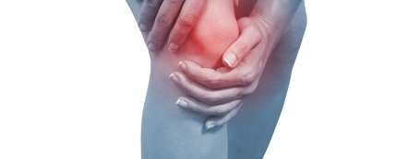
Introduction
INFLAMMATION:
Definition 1: the local response of living body tissues to injury due to any agent.
Definition 2: The complex biological response of body tissues to harmful stimuli, such as pathogens, damaged cells, or irritants

Slide 13
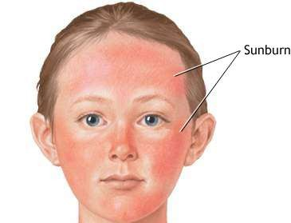
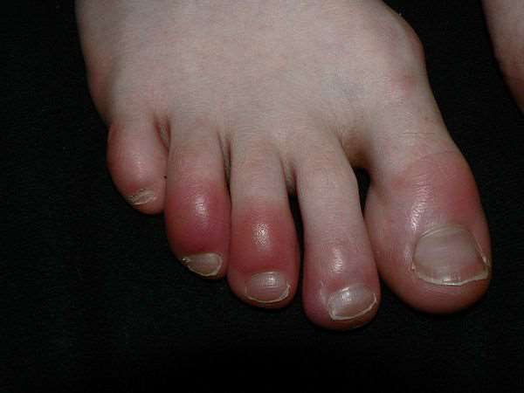
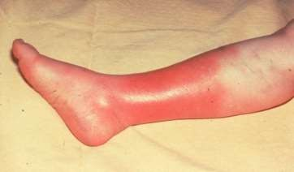

Slide 14
Cont..
Inflammation is a protective response involving;
immune cells,
blood vessels,
molecular mediators
It is also the body defense reaction – to eliminate or limit the spread of injurious agent

Slide 15
Causes of Inflammation
Infective agents like bacteria, viruses, fungi, parasites (and their toxins).
Immunological agents like cell-mediated and antigen antibody reactions.
Physical agents like heat, cold, radiation, mechanical trauma.
Chemical agents like organic and inorganic poisons.
Inert materials such as foreign bodies (chemically inactive)

Slide 16
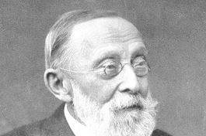
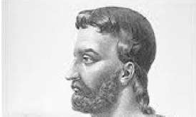

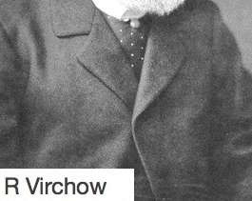
Signs of inflammation
4 cardinal signs (according to Celsus)
Redness
Swelling
Heat
Pain
5th sign
- Loss of function – (according to Virchow)

Slide 17
Types of inflammation
Mainly of 2 types i.e. acute and chronic
Acute Inflammation
short duration
represents the early body reaction- followed by healing
Chronic inflammation
longer duration
causative agent of acute inflammation persists for a long time

Slide 18
INFLAMMATORY RESPONSE/PROCESS/THE PROCESS OF INFLAMMATION
Involves the following events:
VASCULAR EVENTS/RESPONSE
Hemodynamic changes
Altered vascular permeability
CELLULAR EVENTS/RESPONSE
Exudation of leukocytes
Phagocytosis

Slide 19
VASCULAR EVENTS/RESPONSE
a) Hemodynamic changes
Transient vasoconstriction: Is the immediate vascular response to achieve hemostasis irrespective of type of injury .
Persistent progressive vasodilation: Involves mainly arterioles but to a lesser extent, capillaries. It results in increased blood volume in the micro-vascular bed of the site of acute inflammation.
Elevated local hydrostatic pressure: Caused by progressive vasodilation which results in transudation of fluid into the local site causing edema.

Slide 20
Slowing/stasis of microcirculation follows, causing increased concentration of RBCs and thus raised blood viscosity.

Slide 21
Altered vascular –permeability
There are two mechanisms –:
Chemical mediators of acute inflammation may cause retraction of endothelial cells, leaving intercellular gaps (chemical mediated vascular leakage).
Toxins and physical agents may cause necrosis of vascular endothelium, leading to abnormal leakage (injury induced vascular leakage).

Slide 22
CELLULAR EVENTS/RESPONSE
Includes:
i) Formation of the Cellular Exudate
How do white blood cells get out of the circulation and into the area where they are needed?
The movement of leukocytes from the vessel lumen in a directional fashion to the site of tissue damage is called chemotaxis.
All granulocytes and monocytes respond to chemotactic factors and move along a concentration gradient (from an area of lesser concentration of the factor to an area of greater concentration of the factor).

Slide 23
ii) Phagocytosis
The process whereby cells ingest solid particles is termed phagocytosis.
The first step in phagocytosis is adhesion of the particle to be phagocytosed to the cell surface. The phagocyte ingests the attached particle by sending out pseudopodia around it. These meet and fuse so that the particle lies in a phagocytic vacuole (also called a phagosome) bounded by cell membrane. Lysosomes, then fuse with phagosomes to form phagolysosomes. It is within these that intracellular killing of microorganisms occurs.

Slide 24
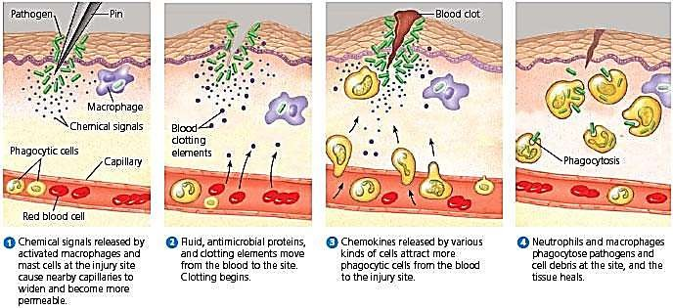
INFLAMMATION PROCESS;

Slide 25
Factors that can influence chronic inflammation;
Dietary factors,
Physical activity,
Smoking
Obesity
Alcohol consumption
Stress can affect inflammation.

Slide 26
DISORDERS OF INFLAMMATION
Inflammatory abnormalities are a large group of disorders that underlie a vast variety of human diseases.
Examples of disorders associated with inflammation include:
Acne vulgaris
Asthma
Autoimmune diseases
Chronic prostatitis
Diverticulitis
Glomerulonephritis
Hypersensitivities

Slide 27
MANAGEMENT OF PATIENTS WITH INFLAMMATION
FEVER/PYREXIA: Occurs due to bacteremia. Administer prescribed antipyretics e.g paracetamol. Give high calorie diet in the form of carbohydrates. This is to meet the increased metabolic demand in patients with fever.
LEUCOCYTOSIS: Usually in bacterial infections there is neutrophilia, viral infections cause lymphocytosis, parasitic infections cause eosinophilia. Administer prescribed antibacterial agents.
DIET: Provide easily digestible diet (light diet), keep the fluid balance, and give high protein diet for the formation of new tissue to build up the destroyed tissue.

Slide 28
SEDATION: Inflammation will produce pain, therefore sedative drugs may be given to induce sleep.
SHOCK: Systematic activation of coagulation pathway may occur leading to microthrombi throughout the body and results into DIC, bleeding and death. Severe tissue injury results in profuse systemic vasodilation, increased vascular permeability and intravascular volume loss causing hypotension and shock. Give plenty of I.V fluids.
PAIN: Immobilize the affected limb, administer prescribed analgesics. Give anti-inflammatory agents e.g ibuprofen, indomethacin, steroids e.g prednisone and dexamethasone.

Slide 29
REST: Elevate the affected limb. The inflamed part is rested by elevation. In case of arms use splints, and for lower limbs use pillows and clear.
LOCAL TREATMENT: If the inflammation is broken and septic, use antiseptics to kill the pathogenic microbes in in the wound. Examples of antiseptics include: hydrogen peroxide, hibitane (Chlorexidine).

Slide 30
Systemic effects of inflammation
Fever : infectious form of inflammation
Anaemia
Leucocytosis
Septic shock

Slide 31
CLASSIFICATION OF
DISEASES

Slide 32
INTRODUCTION
A disease is a particular abnormal condition that affects part or all of an organism and is not caused by external force (injury).
Disease is often interpreted as a medical condition associated with specific symptoms and signs.
It may be caused by external factors such as pathogens or by internal dysfunctions, particularly of the immune system, such as an immunodeficiency, or by a hypersensitivity,
including allergies and autoimmunity.

Slide 33
Diseases may be classified by cause, pathogenesis or by symptom(s).
Alternatively, diseases may be classified according to the organ system involved, though this is often complicated since many diseases affect more than one organ.
The most known and used classification of diseases is the World Health Organization's ICD (International Statistical Classification of Diseases and Related Health Problems). This is periodically updated.

Slide 34
ICD
The International Classification of Diseases (ICD) is the international "standard diagnostic tool
for epidemiology, health management and clinical purposes".
Its full official name is International Statistical Classification of Diseases and Related Health Problems.
The ICD is designed as a health care classification system, providing a system of diagnostic codes for classifying diseases.
It contains codes for diseases, signs and symptoms, abnormal findings, complaints, social
circumstances, and external causes of injury or diseases.
The first international classification edition, known as the International List of Causes of Death, was adopted by the International Statistical Institute in 1893.

Slide 35
Disease classification :
There are four main classes of disease
Genetic disease
Infectious disease (infections)
Neoplasmic (benign or malignant) disease
Traumatic disease (injuries)
Diseases can also be classified as communicable and non-communicable.

Slide 36
i. Genetic disease
A genetic disease is a genetic problem caused by one or more abnormalities formed in the genome.
Most genetic disorders are quite rare
Genetic disorders may be hereditary or non-hereditary, meaning that they are passed down from the parents' genes.
However, in some genetic disorders, defects may be caused by new mutations, altered phenotype, or changes to the DNA.
Examples: albinism, sickle-cell disease, hemophilia etc

Slide 37
ii. Infectious disease (infections)
Infectious diseases are disorders caused by organisms — such as bacteria, viruses, fungi or parasites.
Some infectious diseases can be passed from person to person.
Some are transmitted by insects or other animals. And one may get others by consuming contaminated food or water or being exposed to organisms in the environment.
Signs and symptoms vary depending on the organism causing the infection, but often include fever and fatigue.

Slide 38
Mild infections may respond to rest and home remedies, while some life-threatening infections may need hospitalization.
Many infectious diseases, such as measles and chickenpox, can be prevented by vaccines.
Frequent and thorough hand-washing helps to protect individuals from most infectious diseases.

Slide 39
iii. Neoplasmic (benign or malignant) disease
A neoplasm is a type of abnormal and excessive growth, called neoplasia, of tissue.
The growth of a neoplasm is uncoordinated with that of the normal surrounding tissue, and it persists growing abnormally, even if the original trigger is removed.
This abnormal growth usually (but not always) forms a mass. When it forms a mass, it may be called a tumor.
ICD-10 classifies neoplasms into the following main groups: benign neoplasms, malignant neoplasms, and neoplasms of uncertain or unknown behavior. Malignant neoplasms are also simply known as cancers and are the focus of oncology.

Slide 40
Types of neoplasms
A neoplasm can be benign or malignant (cancer).
Benign tumors include uterine fibroids.
They are circumscribed, localized and do not transform into cancer.
Malignant neoplasms are commonly called cancer.
They invade and destroy the surrounding tissue, may form metastases and, if untreated or unresponsive to treatment, will generally prove fatal.
Secondary neoplasm refers to any of a class of cancerous tumor that is a metastatic offshoot of a primary tumor.
If a metastatic neoplasm has no known site of the primary cancer, it is classified as a cancer of unknown primary origin

Slide 41
iv. Traumatic disease (injuries)
Trauma most often refers to:
Psychological trauma, a type of damage to the psyche that occurs as a result of a severely distressing event
Traumatic injury, sudden physical injury caused by an external force, which does not rise to the level of major trauma

Slide 42
Disease Classification:
The other widely used classifications of disease are :
(1) Topographic, by bodily region or system,
(2) Anatomic, by organ or tissue,
(3) Physiological, by function or effect,
(4) Pathological, by the nature of the disease process,
(5) Etiologic (causal)
(6) Epidemiological

Slide 43
1. Topographic classification
In the topographic classification, diseases are subdivided into such categories as gastrointestinal disease, vascular disease, abdominal disease, and chest disease.
Various specializations within medicine follow such topographic or systemic divisions, so that there are physicians who are essentially vascular surgeons, for example, or clinicians who are specialized in gastrointestinal disease.
Similarly, some physicians have become specialized in chest disease and concentrate principally on diseases of the heart and lungs.

Slide 44
2. Anatomic classification
In the anatomic classification, disease is categorized by the specific organ or tissue affected; hence, heart disease, liver disease, and lung disease.
Medical specialties such as cardiology are restricted to diseases of a single organ, in this case the heart.
Such a classification has its greatest use in identifying the various kinds of disease that affect a particular organ.
The heart is a good example to consider.

Slide 45
3. Physiological classification
The physiological classification of disease is based on the underlying functional derangement produced by a specific disorder.
Included in this classification are such subclasses as respiratory and metabolic disease. Respiratory diseases are those that interfere with the intake and expulsion of air and the exchange of oxygen for carbon dioxide in the lungs.
Metabolic diseases are those in which disturbances of the body’s chemical processes are a basic feature. Diabetes and gout are examples.

Slide 46
4. Pathological classification
The pathological classification of disease considers the nature of the disease process.
Neoplastic and inflammatory disease are examples.
Neoplastic disease includes the whole range of tumors, particularly cancers, and their effect on human beings.
Examples of Inflammatory diseases include: appendicitis, cellulitis, otitis media etc

Slide 47
5. Etiologic classification
The etiologic classification of disease is based on the cause, when known.
This classification is particularly important and useful in the consideration of biotic disease.
On this basis disease might be classified as bacterial (e.g. staphylococcal) or fungal, etc.
Bacteria for example, cause skin infections, pneumonia, meningitis, abscesses in the liver, and kidney infections.
Diseases such as amoebiasis (parasitic), chicken pox (viral), tinea capitis (fungal) and gonorrhea (bacterial) are further examples of diseases classified by etiology.

Slide 48
6. Epidemiological classification
The epidemiological classification of disease deals with the incidence, distribution, and control of disorders in a population.
To use the example of typhoid, a disease spread through contaminated food and water, it first becomes important to establish that the disease observed is truly caused by Salmonella typhi, the typhoid organism.
Once the diagnosis is established, it is important to know the number of cases, whether the cases were scattered over the course of a year or occurred within a short period, and what the geographic distribution is.

Slide 49
COMMON MEDICAL SURGICAL CONDITIONS

Slide 50
ABSCESS

Slide 51
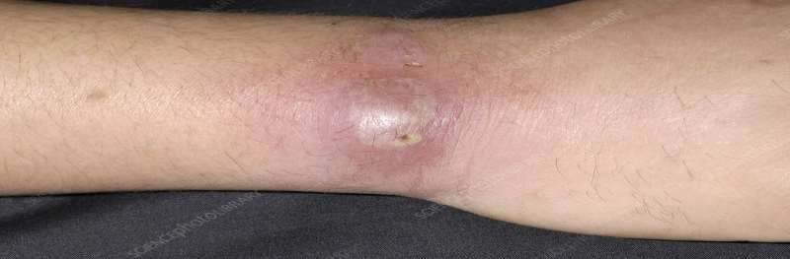
Abscess
Definition 1: An abscess is a cavity filled with pus . It contains white blood cells, dead tissue and bacteria.
Definition 2: localized collection of pus surrounded by inflamed tissue

Slide 52
TYPES OF ABSCESS
Abscesses can develop anywhere in the body.
Skin abscesses – which develop under the skin
Internal abscesses – which develop inside the body, in an organ or in the spaces between organs
Incisional abscess - An incisional abscess is one that develops as a complication secondary to a surgical incision.
It presents as redness and warmth at the margins of the incision with purulent drainage from it.
If the diagnosis is uncertain, an abscess should be aspirated with a needle, and the aspirated pus be presented for culture and sensitivity

Slide 53
Other abscesses
There are many other types of abscess, including:
Anorectal abscess – a build-up of pus in the rectum and anus
Bartholin's abscess – a build-up of pus inside one of the Bartholin's glands, which are found on each side of the opening of the vaginal orifice.
brain abscess – a rare but potentially life-threatening build-up of pus
inside the skull (cranium)
Dental abscess – a build-up of pus under a tooth or in the supporting gum and bone
Quinsy (peritonsillar abscess) – a build-up of pus between one of the tonsils and the wall of the throat (as complication of tonsilitis)
spinal cord abscess – a build-up of pus around the spinal cord

Slide 54
Causes of abscesses
Most abscesses are caused by a bacterial infection, parasites, or foreign substances, but bacteria is most common cause.
When bacteria enter the body, the immune system sends infection-fighting white blood cells to the affected area.
As the white blood cells attack the bacteria, some nearby tissues die, creating a space which then fills with pus to form an abscess. The pus contains a mixture of dead tissue, white blood cells and bacteria.

Slide 55
Internal abscesses often develop as a complication of an existing condition, such as an infection elsewhere in your body. For example, if the appendix bursts as a result of appendicitis, bacteria can spread inside the abdomen and cause an abscess to form.
The most common bacterial organism responsible for the development of skin abscesses is Staphylococcus aureus
With the emergence of methicillin-resistant Staphylococcus aureus (MRSA), health care providers must now consider this organism as the possible cause when a skin abscess is encountered.

Slide 56
Pathophysiology:
Upon entry of the organisms or foreign materials, Staphylococcus aureus for example kills the local cells, resulting in the release of cytokines.
The cytokines trigger an inflammatory response, which draws large numbers of white blood cells to the area and increases the regional blood flow.
The final structure of the abscess is an abscess wall, or capsule, that is formed by the adjacent healthy cells in an attempt to keep the pus from infecting neighboring structures.
However, such encapsulation tends to prevent immune cells from attacking bacteria in the pus, or from reaching the causative organism or foreign object.

Slide 57
Signs and Symptoms of skin abscesses:
A skin abscess often appears as a swollen, pus-filled lump under the surface of the skin.
Body malaise
Other symptoms of an infection, such as a fever,
chills.
warmth
redness (in the affected area)
A boil is a common example of a skin abscess.

Slide 58
common signs and Symptoms of internal abscesses
The signs and symptoms of an internal abscess can also vary depending on exactly where in the body the abscess develops.
For example, a liver abscess may cause jaundice, whereas an abscess in or near the lungs may cause a cough or shortness of breath.

Slide 59
General signs and symptoms of an internal abscess can include:
Discomfort in the area of the abscess
Fever
Increased sweating
Vomiting
Chills
Pain or swelling in the abdomen
Loss of appetite
Weight loss
Extreme tiredness (fatigue)
Diarrhoea or constipation

Slide 60
Risk factors:
You’re at increased risk for this bacterial infection if you have:
Close contact with an individual who has a staph infection, (which is why these infections are more common in hospitals)
A chronic skin disease, like acne or eczema
Diabetes
A weakened immune system, which can be caused by infections such as HIV
Poor hygiene habits

Slide 61
Risk factors cont..
Infected hair follicles (folliculitis)
Infected hair follicles, or folliculitis, may cause abscesses to form in the follicle. Follicles can become infected if the hair within the follicle is trapped and unable to break through the skin, as can happen after shaving.
Trapped hair follicles are commonly known as ingrown hairs. Ingrown hairs can set the stage for an infection. Abscesses that are on or in a hair follicle will often contain this ingrown hair.
Folliculitis may also occur after spending time in an inadequately chlorinated pool or hot tub.

Slide 62
Investigations
When taking medical history, ask:
How long the abscess has been present
If they recall any injury to that area
What drugs one may be taking
If they have any allergies
If they had a fever
Physical exam. Examine the abscess and surrounding areas.
Take a culture or a small amount of fluid from the abscess to test for the presence of bacteria

Slide 63
Difference between cyst and abscess
CYST
ABSCESS
A cyst is a closed sac that develops abnormally in some body structure
Symptoms:
A cyst grows slowly and isn’t usually painful, unless it becomes enlarged.
When an already-formed cyst becomes infected, it becomes an abscess.
Not infected.
An abscess is a pus-filled infection in the body caused by, for example, bacteria or fungi.
Symptoms:
Pain, redness, and swelling and can cause symptoms elsewhere in the body.
An abscess doesn’t have to begin as a cyst. It can form on its own.
An abscess is infected

Slide 64
Skin abscesses
Some small skin abscesses may drain naturally & get better without the need for treatment.
For larger or persistent skin abscesses, a course of Antibiotics may be prescribed to help clear the infection and prevent it from spreading.
Internal abscesses
The pus usually needs to be drained from an internal abscess, either by using a needle inserted through the skin (percutaneous abscess drainage) or with surgery.
The method used will depend on the size of the abscess and where it is in the body.
Antibiotics will usually be given at the same time, to help kill the infection and prevent it from spreading. These may be given as orally or intravenously.

Slide 65
Treatment:
A small skin abscess may drain naturally, or simply shrink, dry up and disappear without any treatment.
Abscesses can be treated in a number of different ways, depending on the type of abscess and how large it is.
The main treatment options include:
antibiotics
a drainage procedure
warm compress
Surgery

Slide 66
Surgery (Incision and drainage)
If the skin abscess needs draining, the patient will have a minor surgical operation carried out under anesthesia– usually a local anesthetic
During the procedure, an incision is made in the abscess, to allow the pus to drain out. A sample of pus may also be taken for testing.
Once all of the pus has been removed, the resulting hole that is left by the abscess is cleaned using sterile saline (a salt solution).
The abscess will be left open but covered with a wound dressing, so if any more pus is produced it can drain away easily.
If the abscess is deep, an antiseptic dressing may be placed inside the wound to keep it open. The procedure may leave a small scar.

Slide 67
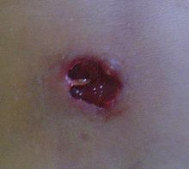
Abscess five days after incision and drainage

Slide 68
Percutaneous drainage
If the internal abscess is small, the surgeon may be able to drain it using a fine needle.
Depending on the location of the abscess, this may be carried out using either a local or general anaesthetic.
The surgeon may use ultrasound scans or computerised tomography (CT) scans to help guide the needle into the right place.
Once the abscess has been located, the pus is drained using the needle. A small incision may be made on the skin over the abscess, then insert a thin plastic tube called a drainage catheter into it.

Slide 69
The catheter allows the pus to drain out into a bag and may have to be left in place for up to a week.
This procedure may be carried out as a day case procedure, which means the patient may be able to go back home the same day, although some people will need to stay in hospital for a few days.
You may need to undergo surgery if:
Your internal abscess is too large to be drained with a needle
A needle can't get to the abscess safely
Needle drainage hasn't been effective in removing all of the pus
The type of surgery will depend on the type of internal abscess and where it is in the body.

Slide 70
Prevention of abscesses
Proper hygiene is the best way to avoid infection.
Keep cuts and wounds clean, dry, and covered to protect them from microorganisms.
Avoid sharing clothing, towels, razors, or bed linens with anyone else.
When these items get dirty, wash them separately in hot water.
Wash your hands well and often using soap and water for at least 20 seconds each time. It's OK to use alcohol-based instant hand sanitizers or wipes if you're not near any soap and water.

